Slide 1
GIT & GITHUB
About Git - GitHub Docs
Git – Reference
How does GitHub compare to other DevOps tools?
GitHub CLI | Take GitHub to the command line

Slide 2
Git
Type: Software (specifically, a version‑control system).
What it does: Tracks changes in files and code over time.
Purpose: Lets developers collaborate, roll back mistakes, and manage versions of projects.
Where it runs: Installed locally on your computer — you use it through the command line (CLI) or tools like PowerShell, Git Bash, or VS Code.
git commit -m "Save changes“ (Example)

Slide 3
GitHub
Type: Online platform (a web‑based service, not software you install).
What it does: Hosts Git repositories in the cloud so people can share, collaborate, and contribute to projects.
Purpose: Acts as a social and collaborative layer on top of Git — with features like pull requests, issues, and discussions.
Access: Through a browser (github.com) or via tools like GitHub CLI or GitHub Desktop.

Slide 4
Feature | Git | GitHub
Nature | Software | Web platform
Runs on | Your computer | The internet
Purpose | Version control | Collaboration & hosting
Example use | Track code changes | Share code with others

Slide 5
Key takeaway:
Git = the engine that manages versions of your code.
GitHub = the garage where you store and share those versions online.
Would you like me to show you how Git and GitHub work together step‑by‑step (from local commits to pushing code to GitHub)? It’s a great way to see their relationship in action.

Slide 6
Git
Git is software — specifically a version control system created by Linus Torvalds in 2005.
It’s written primarily in the C programming language, with some parts in Shell scripts and Perl/Python for supporting tools.
That’s why Git is fast and efficient — C gives it low‑level control over performance.

Slide 7
GitHub
GitHub is not software you install — it’s a web‑based platform (a service) that hosts Git repositories online.
It’s built using a mix of technologies (Ruby on Rails, Go, and other web frameworks), but you don’t need to worry about its internal language.
You interact with GitHub through your browser, GitHub Desktop, or GitHub CLI.
In short
Git → software tool, written mainly in C.
GitHub → online platform/service, not just “software,” but a cloud‑based collaboration hub built on top of Git.
✅ Key takeaway: Git is the engine (coded in C), GitHub is the garage (a platform) where you store and share your projects.

Slide 8
Git + GitHub Today
Git + GitHub Today
Git = the version control engine (software).
GitHub = the collaboration platform (cloud service). Together, they power open‑source communities, enterprise DevOps, and even AI‑assisted coding.
Key takeaway: Git started as a 10‑day hack in 2005, GitHub made it mainstream in 2008, and by 2026 it has become the universal language of software collaboration.

Slide 9
Global Desktop OS Usage (2026)
Windows: ~71.2%
macOS (combined OS X/macOS): ~19.8%
Linux: ~7.5% (record high in July 2026, up from ~3% in 2022)
Chrome OS: ~1.5% ➡️ Takeaway: Windows is still the everyday desktop leader, but Linux has grown significantly, especially after Windows 10 support ended in 2025

Slide 10
Linux is not the leading operating system worldwide for everyday desktop use — Windows still dominates with over 70% share — but Linux is the undisputed leader in servers, supercomputers, and cloud infrastructure, powering more than half of all servers and 100% of the world’s Top500 supercomputers.

Slide 11
GitHub is based on the open-source software, Git.
Git is a version control system that tracks changes to files. It lets you work on your own copy of a project, record a history of your changes, and merge your work with other people's changes safely.
GitHub builds on Git by hosting your Git projects, called repositories, in the cloud, as well as adding planning and collaboration tools that make it easier for teams to work together.
Host documentation and websites.
Create a repository for your software project and store the code on GitHub, see Creating a repository for your project on GitHub.

Slide 12
In Windows, you’ll often hear about Command Prompt and PowerShell — they look similar (both are text‑based consoles), but they serve different purposes and have different strengths:
Command Prompt (cmd.exe)
What it is: The traditional command‑line interpreter in Windows, around since the MS‑DOS days.
Usage:
Running basic commands like dir (list files), copy, del, ping.
Useful for simple file operations, network checks, and batch scripts (.bat files).
Limitations:
Only supports a limited set of commands.
Not designed for modern automation or advanced scripting.

Slide 13
PowerShell
What it is: A more advanced shell introduced by Microsoft in 2006, built on the .NET framework.
Usage:
Runs everything Command Prompt can, plus much more.
Uses cmdlets (specialized commands) like Get-Process, Get-Service, Get-ChildItem.
Can automate complex tasks (system administration, cloud management, DevOps).
Supports scripting with .ps1 files.
Strengths:
Object‑oriented: instead of just text, it passes structured data (objects) between commands.
Integrates with Windows internals, Active Directory, Azure, GitHub, and more.
Ideal for IT professionals and developers.

Slide 14
Quick Comparison
Feature | Command Prompt | PowerShell
Age | Legacy (DOS era) | Modern (2006+)
Commands | Basic text commands | Advanced cmdlets + legacy commands
Scripting | Batch files (.bat) | PowerShell scripts (.ps1)
Data handling | Text only | Objects (structured data)
Use cases | Simple tasks | Automation, administration, DevOps

Slide 15
Key takeaway
Command Prompt = simple, old‑school tool for basic commands.
PowerShell = powerful, modern tool for automation and system management.
For practice and learning Git/GitHub, you can use either — but PowerShell is more flexible and closer to what professionals use today.
Since you’re exploring GitHub right now, would you like me to show you the most common Git commands in PowerShell (like git init, git add, git commit, git push) so you can start practicing directly in Windows?

Slide 16
Powershell
git init
git status
git add filename.txt
git add .
git commit -m "Initial commit“ 4.commit changes
git remote add origin 5.Connect to GitHub(remote https://github.com/YourUsername/YourRepo.git 6. Push changes
git push -u origin main
git pull origin main pull updates from github

Slide 17
Here’s a mini GitHub practice exercise you can try right now in PowerShell on Windows.
1 Create a New Folded on powershell mkdir GitPractice
cd GitPractice
2 Create simple text file echo “Hello GitHub! This is my first practice file.” >practice.txt
2 navigate to your project
cd C:\Users\Bon\Documents\MyProject
3 git init initialize Git this sets up a new Git repository in the folder
4. git add practice.txt Stage the file This tells Git to track the file for the next commit
5. git commit -m “Add practice.txt with hello message” Commit the file. This saves a snapshot of your file in Git history.
6, Create a repo on GitHub → copy its URL. Connect to GitHub
git remote add origin <URL>
git push -u origin main

Slide 18
Key takeaway:
git init → start a repo
git add → stage files
git commit → save snapshot
git push → upload to GitHub

Slide 19
Step 6: Connect to GitHub
Go to GitHub and create a new repository (e.g., GitPractice).
Copy the repository URL (something like https://github.com/YourUsername/GitPractice.git).
Link your local repo to GitHub:
git remote add origin https://github.com/YourUsername/GitPractice.git

Slide 20
Step 7: Push to GitHub
git push -u origin main
This uploads your commit to GitHub. (If your default branch is master, replace main with master.)
This uploads your commit to GitHub. (If your default branch is master, replace main with master.)

Slide 21
Step 1: Create a New Folder
mkdir GitPractice
cd GitPractice
Step 2: Create a Simple Text File
echo "Hello GitHub! This is my first practice file." > practice.txt
This creates a file called practice.txt with one line of text.
Step 3: Initialize Git
git init
This sets up a new Git repository in the folder.

Slide 22
Step 4: Stage the File
git add practice.txt
This tells Git to track the file for the next commit.
Step 5: Commit the File
git commit -m "Add practice.txt with hello message"
This saves a snapshot of your file in Git history.

Slide 23
Step 6: Connect to GitHub
Go to GitHub and create a new repository (e.g., GitPractice).
Copy the repository URL (something like https://github.com/YourUsername/GitPractice.git).
Link your local repo to GitHub:
git remote add origin https://github.com/YourUsername/GitPractice.git

Slide 24
Step 7: Push to GitHub
powershell
git push -u origin main
This uploads your commit to GitHub. (If your default branch is master, replace main with master.)
Result: You’ll now see your practice.txt file in your GitHub repository online.

Slide 25
Here’s a mini GitHub practice exercise with a 2‑week plan so you can steadily build confidence using Git commands in PowerShell on Windows:
Day 1–3: Basics
Create a folder → mkdir GitPractice && cd GitPractice
Make a file → echo "Hello GitHub!" > practice.txt
Initialize repo → git init
Stage → git add practice.txt
Commit → git commit -m "First commit"

Slide 26
Day 4–6: Connect to GitHub
Create a new repo on GitHub (name: GitPractice).
Link it →
powershell
git remote add origin https://github.com/YourUsername/GitPractice.git
Push →
powershell
git push -u origin main

Slide 27
Day 7–9: Editing & Updating
Edit your file → echo "Second line of text" >> practice.txt
Stage & commit →
powershell
git add practice.txt
git commit -m "Added second line"
Push again → git push

Slide 28
Day 10–12: Pulling & Branching
Pull updates → git pull origin main
Create a branch → git checkout -b feature-branch
Make edits, commit, push branch →
powershell
git push origin feature-branch

Slide 29
Day 13–14: Merging
Switch back → git checkout main
Merge branch → git merge feature-branch
Push final changes → git push
✅ Result: By the end of 2 weeks, you’ll have practiced:
Initializing repos
Adding/committing files
Pushing/pulling to GitHub
Branching and merging

Slide 30
design a cheat sheet of the top 10 Git commands (with one‑line explanations) so you can keep it handy while practicing?
🔢 Command | 💡 One‑Line Explanation
git init | Create a new Git repository in the current folder.
git clone <URL> | Copy an existing repository from GitHub to your computer.
git status | Show which files are modified, staged, or untracked.
git add <file> | Stage a file (or use git add . to stage all changes).
git commit -m "message" | Save a snapshot of staged changes with a message.
git push origin main | Upload commits from your local repo to GitHub.
git pull origin main | Fetch and merge updates from GitHub into your local repo.
git branch | List, create, or delete branches.
git checkout -b <branch> | Create and switch to a new branch.
git merge <branch> | Combine another branch’s changes into the current one.

Slide 31
Quick Tips
Always run git status before committing — it’s your progress dashboard.
Use short, clear commit messages (e.g., "Fix login bug").
Push often to keep your GitHub repo synced.
Experiment safely in branches — they’re your playground for new ideas.

Slide 32
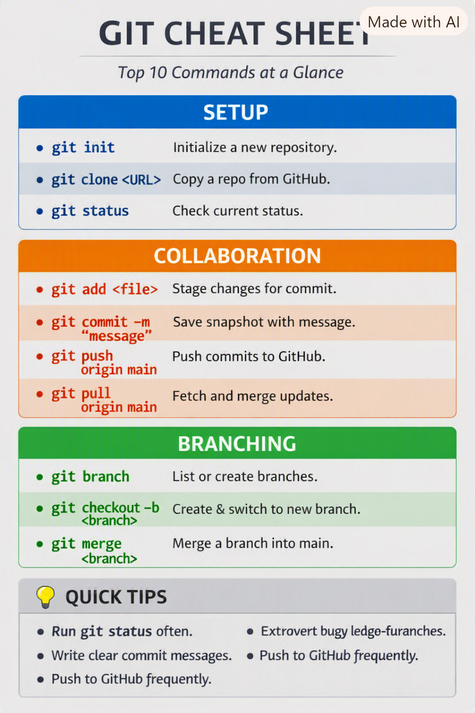

Slide 33
what kind of software developmemnt is done on GIT? Is the normal sottware we use like python, c,c++, java or something else?
What Kind of Development Happens on Git?
Git itself is not a programming language — it’s a version control system.
That means Git doesn’t care what language your project is written in. It simply tracks changes to files over time.
Developers use Git to manage any kind of software project — whether it’s Python scripts, C/C++ applications, Java projects, JavaScript web apps, or even non‑code files like documentation, CAD designs, or configuration files.

Slide 34
Examples
Python: Data science notebooks, web apps (Django, Flask).
C / C++: System software, embedded systems, game engines.
Java: Enterprise apps, Android development.
JavaScript / TypeScript: Web front‑end frameworks (React, Angular, Vue).
Other: Go, Rust, PHP, Ruby, Swift, Kotlin — all tracked with Git.

Slide 35
GitHub’s Role
GitHub (the platform) hosts these Git repositories online.
That’s why you’ll find everything from Linux kernel (C) to TensorFlow (Python/C++) to React (JavaScript) on GitHub.
GitHub is language‑agnostic — it’s a collaboration hub for all programming languages.
Key takeaway: Git is the tool for version control, not a language. Developers use it to manage projects in any programming language — Python, C, C++, Java, JavaScript, Rust, Go, and beyond.
Would you like me to show you a list of the top programming languages most used on GitHub today (with percentages) so you can see which ones dominate the Git ecosystem?

Slide 36
On GitHub in 2026, the most used programming languages are Python, TypeScript, JavaScript, Rust, and Go — with Python leading overall thanks to AI/ML projects, and TypeScript overtaking Python in contributor count for the first time.

Slide 37
Rank | Language | Share / Activity | Key Use Cases
1. Python | ~21.8% global share (TIOBE Index, Feb 2026) | AI/ML, data science, automation, back‑end, scripting
2. TypeScript | Surpassed Python in GitHub contributors (Aug 2025) | Scalable web apps, front‑end + back‑end, large team projects
3. JavaScript | 2.4M GitHub stars, dominant in web dev | Web front‑end frameworks (React, Angular, Vue)
4. Rust | 851K stars, fastest growth in systems programming | High‑performance, memory‑safe systems, blockchain
5. Go | 2.3M stars, cloud‑native leader | Cloud infrastructure, Kubernetes, microservices
6. Java | 2.2M stars, enterprise staple | Enterprise apps, Android, JVM ecosystem
7. C++ | 523K stars | Game engines, embedded systems, performance‑critical apps
8. C | 332K stars | OS kernels, embedded devices, low‑level systems
9. C# | 263K stars | Windows apps, Unity game development
10. Shell / Bash | 497K stars | Automation scripts, DevOps tooling

Slide 38
Key Trends in 2026
Python remains dominant in AI/ML repositories (TensorFlow, PyTorch, scikit‑learn).
TypeScript is the big story — it became the most used language on GitHub by contributor count in 2025, marking the first major shift in over a decade.
Rust and Go are rising fast: Rust for safe systems programming, Go for cloud‑native infrastructure.
JavaScript still rules web development, but TypeScript is preferred for large, scalable projects.
Traditional languages (C, C++, Java) remain strong in enterprise, embedded, and performance‑critical domains.

Slide 39
Takeaway for You (Bon, in India)
If you’re practicing Git/GitHub, Python and TypeScript are the most valuable to learn right now.
Python → great for AI, data science, automation.
TypeScript → essential for modern web and full‑stack development.
Rust/Go → excellent if you want to explore cutting‑edge systems or cloud infrastructure.
Would you like me to design a visual GitHub language popularity chart (2026) so you can instantly see how Python, TypeScript, Rust, and others compare side‑by‑side?

